Slide 1






ASP.NET MVC Course
Course Content, Evaluation, Exams
ASP.NET MVC
Telerik Software Academy
http://academy.telerik.com

Slide 2

Table of Contents
What you have been through?
ASP.NET MVC Course Program
The Trainers Team
Exams and Evaluation
Standard Criteria
Bonuses
Resources for the Course

Slide 3
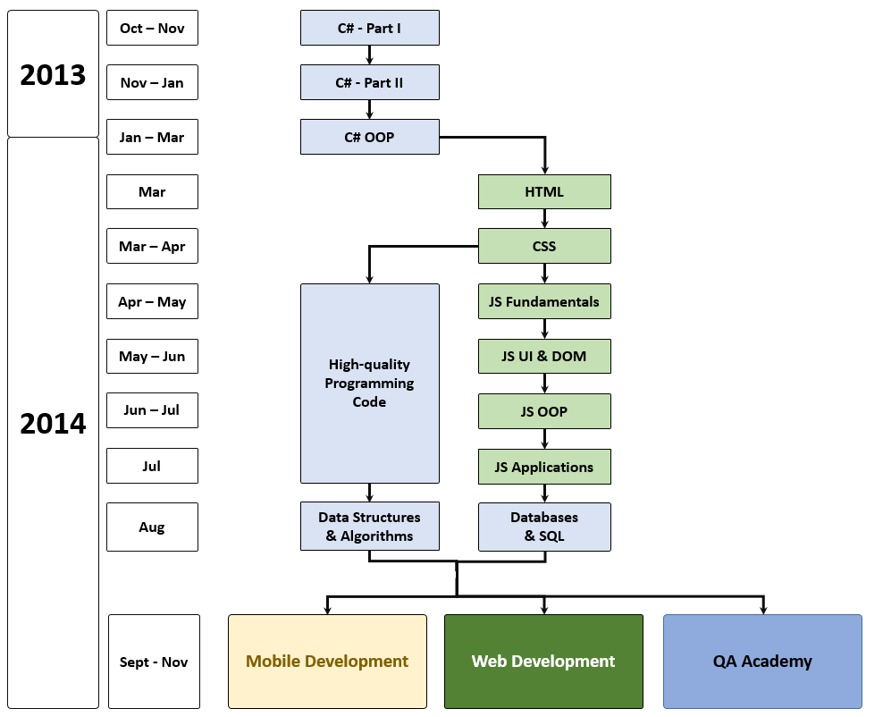
What you have been through?

Slide 4
What you have been through?
Mobile Development
Web Development
Sep 2014
Web Services & Cloud Technologies
Web Services & Cloud Technologies
Sep 2014
Hybrid Mobile Apps with Apache Cordova
SPA applications with JavaScript
Oct 2014
Android Apps
End-to-end Applications with NodeJS
Oct 2014
iOS Apps
Web Applications with ASP.NET Web Forms
Nov 2014
Windows Phone 8 Apps
Web Applications with ASP.NET MVC

Slide 5


ASP.NET MVC
What Will We Cover in the Course?

Slide 6


ASP.NET MVC Course Program
Course Introduction
Introduction to ASP.NET MVC
ASP.NET MVC Essentials
AJAX in ASP.NET MVC
Web Security and ASP.NET
Working with Data
Kendo UI ASP.NET MVC Wrappers

Slide 7
ASP.NET MVC Course Program
Caching Data
IIS Deployment
SignalR
Bootstrap
ASP.NET MVC Advanced Topics
Exam Preparation
Project defense
Exam (17 November 2014)
ASP.NET vNext Seminar (22 November 2014)

Slide 8
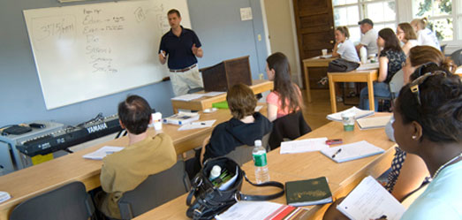
The Trainers Team

Slide 9
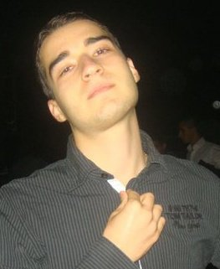
Trainers Team
Nikolay Kostov
Team Lead, Senior Developer and Trainer @ Telerik Corp.
Student at Sofia University
Computer Science
IT and Informatics competitions contestant
Graduate from the second season of Telerik Software Academy
Email: nikolay.kostov [at] telerik.com
Blog: http://nikolay.it
GitHub: http://github.com/NikolayIT

Slide 10
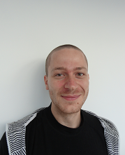
Trainers Team (2)
Ivaylo Kenov
Technical Trainer @ Telerik Software Academy
Graduate from the fourth season of Telerik Software Academy
Mathematical competitions contestant
E-mail: ivaylo.kenov [at] telerik.com
Champion in OOP and DSA
Blog: http://ivaylo.bgcoder.com
GitHub: https://github.com/ivaylokenov

Slide 11



Evaluation
Thank God There Are Bonuses!

Slide 12

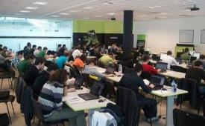
Course Evaluation
Evaluation
Practical exam – 60%
Peer review (at least 10)
Individual Project – 35%
Instead of homework and team projects
We will send you project requirements
Unique projects!
Something to show when applying for a job
Attendance in class – 5%
Bonuses
Forums activity – bonus up to 5%

Slide 13


Pass / Excellence / Fail Criteria
Criteria for pass / pass with excellence / fail
Pass with excellence
Very high exam or project results
or
High total results (project + exam)
Pass
Average total results
Fail
Low results on the individual project
Low total results or low exam results

Slide 14
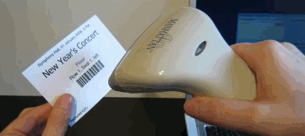
Check Your Presence
You should check your presence on the barcode reader 2 times a day:
In the morning when lectures begin (~10:30)
After lunch break (~13:30)
Don't check your friends if they are not in class

Slide 15








Resources
What We Need in Addition to this Course Content?

Slide 16

Course Web Site & Forums
Register for the "Telerik Academy Forums":
Discuss the course exercises with your colleagues
Find solutions for the exercises
Share source code / discuss ideas
The course official web site:
http://forums.academy.telerik.com/web-development/asp-net-mvc
http://academy.telerik.com/student-courses/software-technologies/aspnet-mvc/about

Slide 17
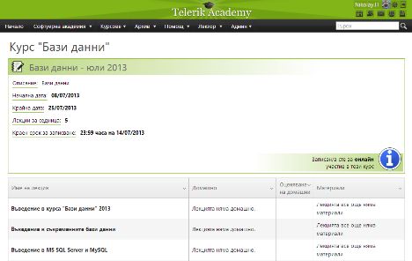
Telerik Integrated Learning System (TILS)
The Telerik Integrated Learning System (TILS)
www.telerikacademy.com
Important resource for all students
Homework submissions
Homework peer reviews
Presence cards with barcode
Reports about your results
telerikacademy.com/Courses/Courses/Details/200

Slide 18




Required Software
Software needed for this course:
Microsoft Visual Studio 2013 (with updates)
ASP.NET Web Frameworks and Tools 2013
Internet Information Services (IIS) 8.0
Microsoft SQL Server 2012

Slide 19


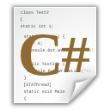


ASP.NET MVC: Course Introduction
http://academy.telerik.com

Slide 20




Free Trainings @ Telerik Academy
C# Programming @ Telerik Academy
csharpfundamentals.telerik.com
Telerik Software Academy
academy.telerik.com
Telerik Academy @ Facebook
facebook.com/TelerikAcademy
Telerik Software Academy Forums
forums.academy.telerik.com

